Slide 1
Value Proposition Canvas

Slide 2
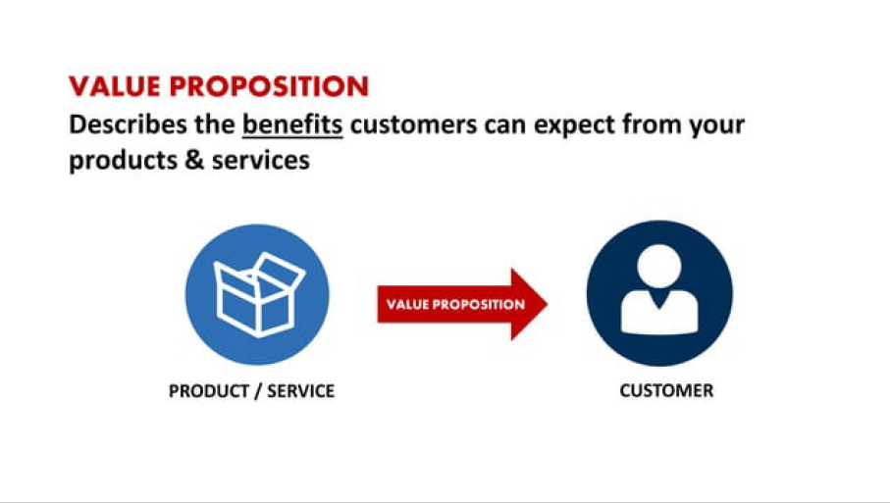
Value Proposition Canvas is a business model tool that helps you make sure that a company’s product or service is positioned around customers’ values and needs. The tool has been created by Alexander Osterwalder, Yves Pigneur, and Alan Smith.
In few words, this tool comes to facilitate the job of putting yourself in your customers’ shoes and understanding their world.

Slide 3
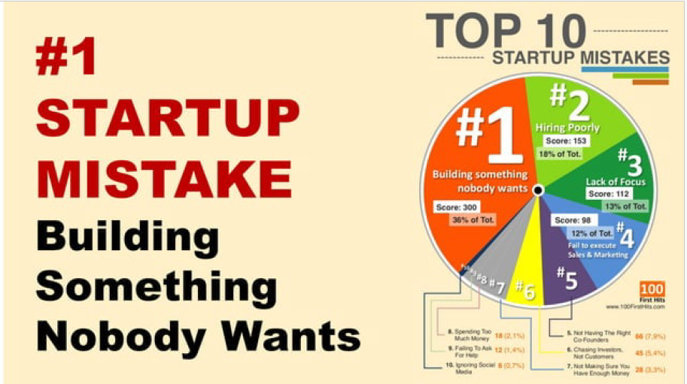

Slide 4
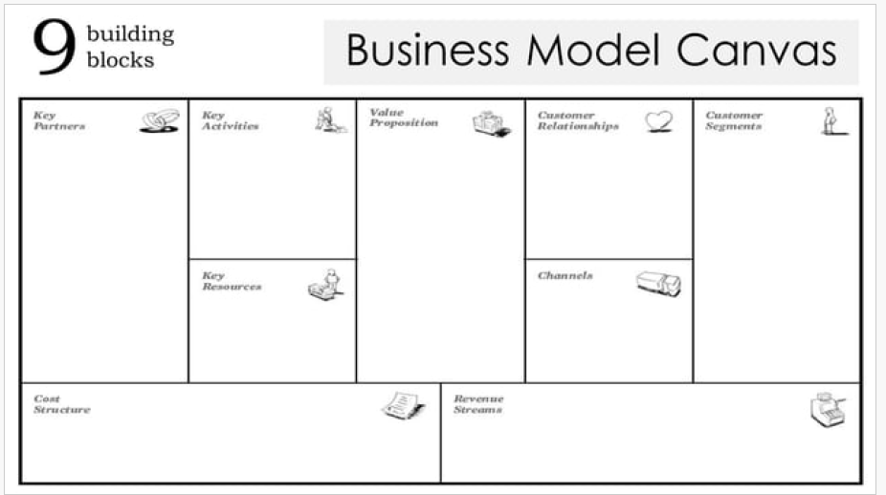
The BMC gives you a holistic overview of your entire business model,
The Business Model Canvas covers a wider scope, encompassing all elements of the business model. – It is often used for strategic planning and business model innovation.

Slide 5
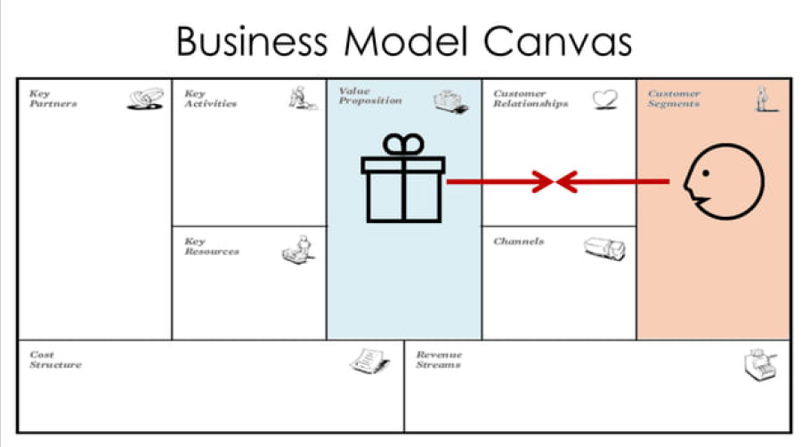

Slide 6
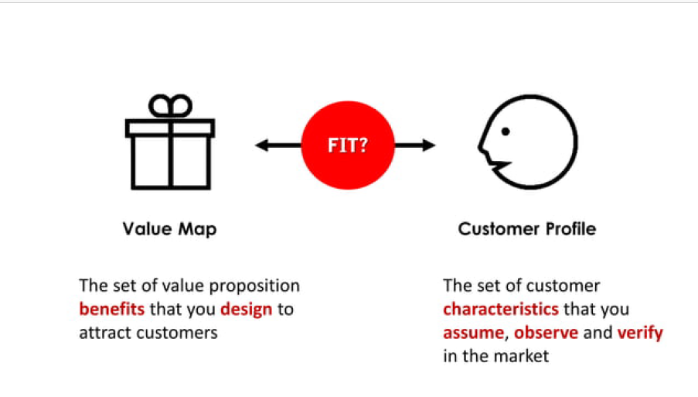
VPC zooms in on the specific value proposition that you offer to a specific customer segment.

Slide 7
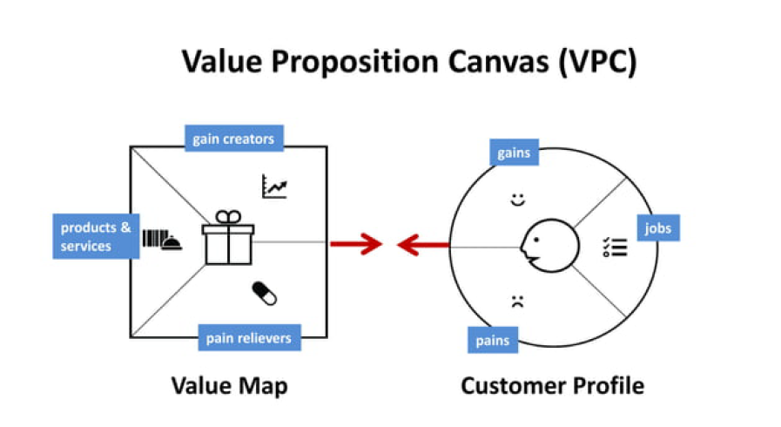
Value Proposition Canvas is made up of only two blocks – Value Proposition and Customer Segment. They are the core of the business model because they focus on “What” and “To whom”. In other words, how your company delivers value to your audience.

Slide 8
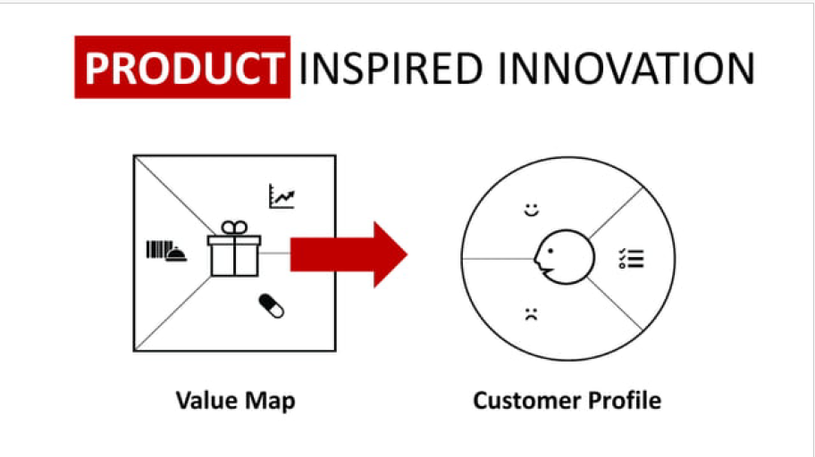

Slide 9
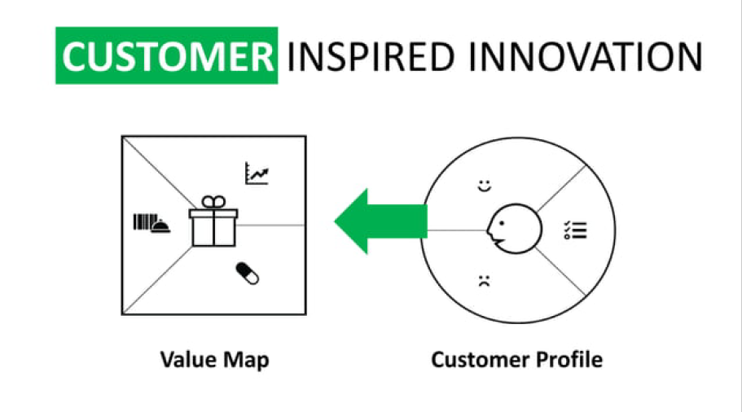

Slide 10
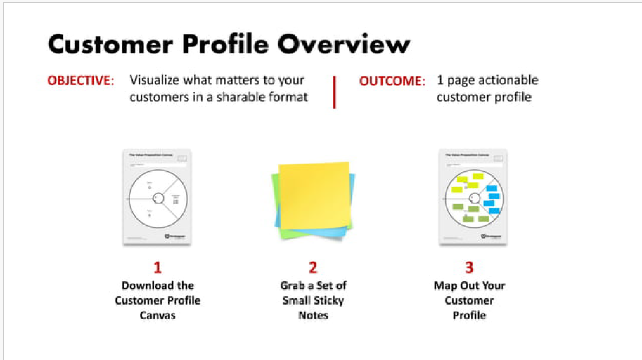

Slide 11
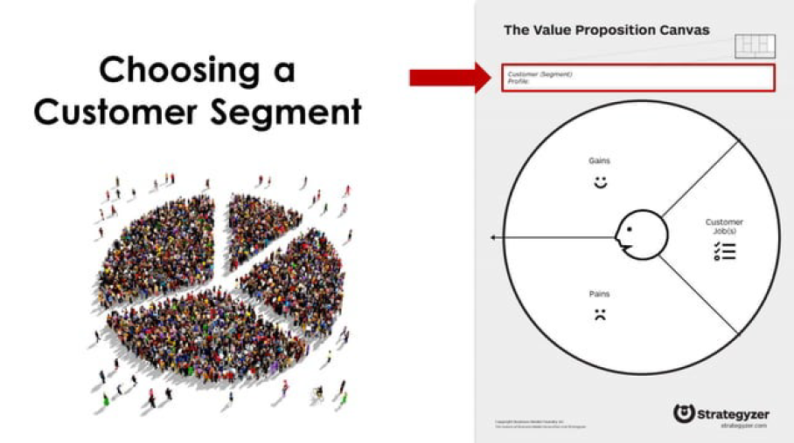

Slide 12
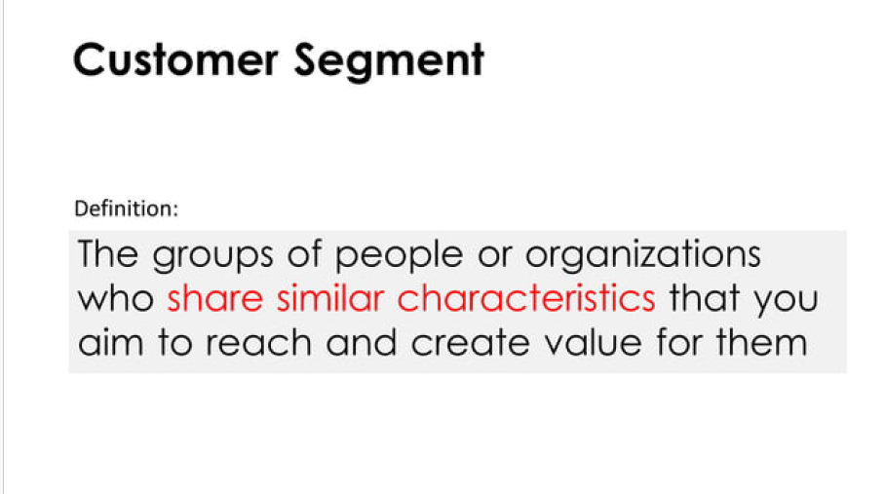

Slide 13
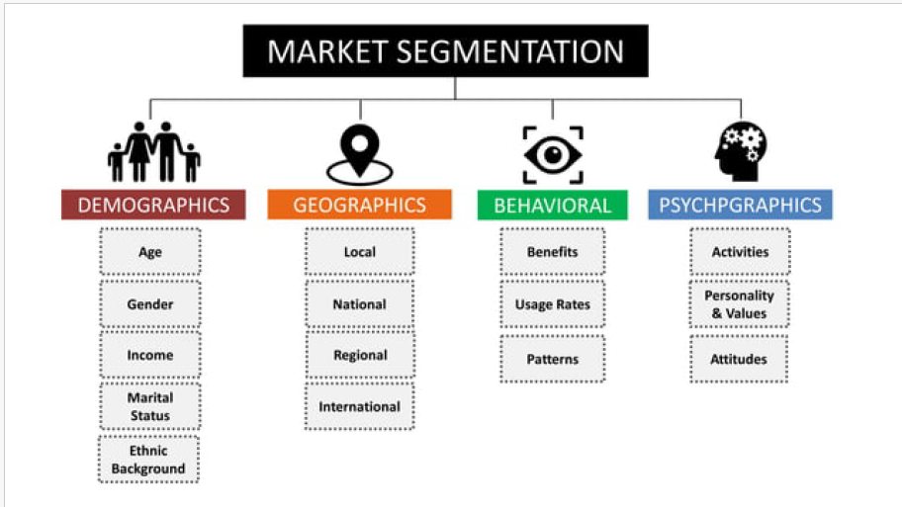

Slide 14
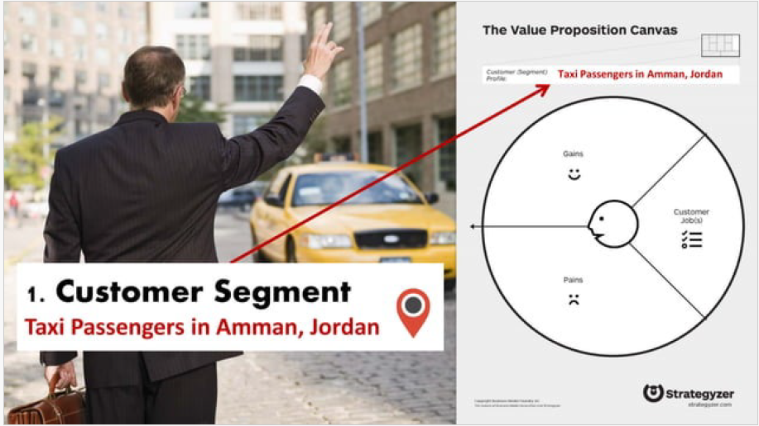

Slide 15
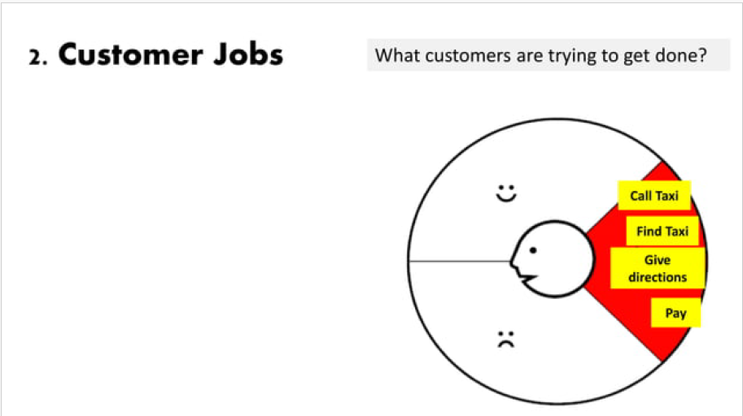
This is about what your customer is trying to do. You have to include all tasks customers are trying to perform, the problems they are trying to solve, and the needs they want to satisfy.
To fulfill this step, you may ask yourself:
What functional task, social task, emotional task is my customer trying to perform or accomplish?
What basic needs do they need/want to have satisfied

Slide 16
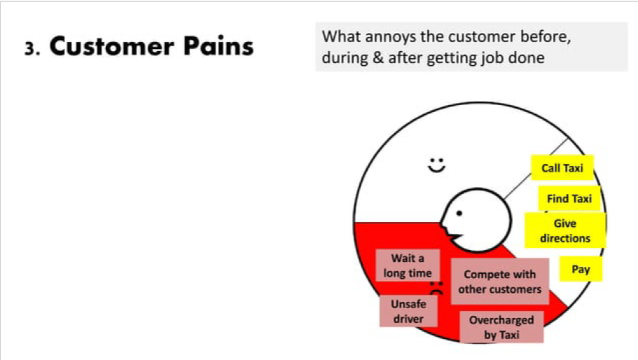
This one encompasses everything that annoys your customer while they are performing their jobs-to-be-done, such as negative experiences and emotions, challenges, risks involved, financial costs, mistakes, and consequences, etc.

Slide 17
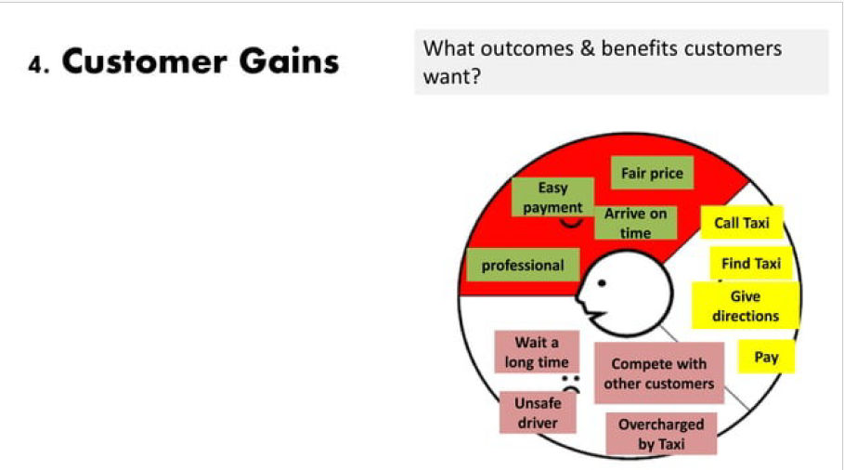
They are all the benefits your customer expects or wishes – or even something that would surprise them positively –, whether they are functional, emotional, social or financial. In short, everything that delight them and make their life easier, more joyful or more successful.

Slide 18
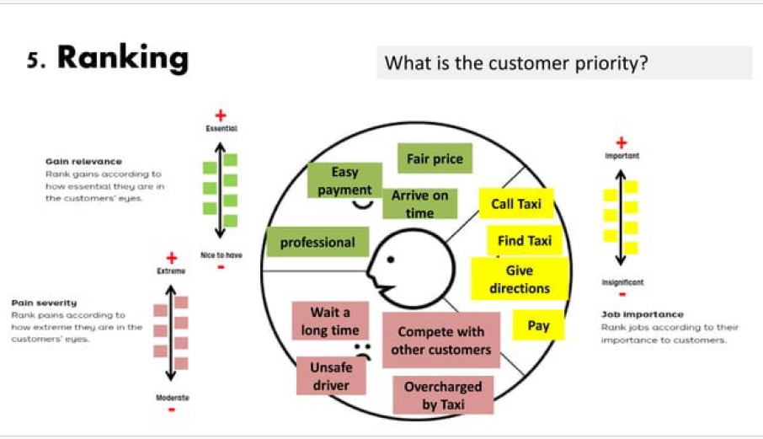

Slide 19
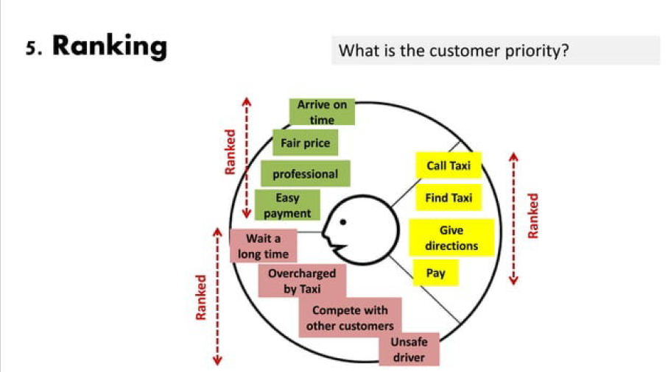

Slide 20
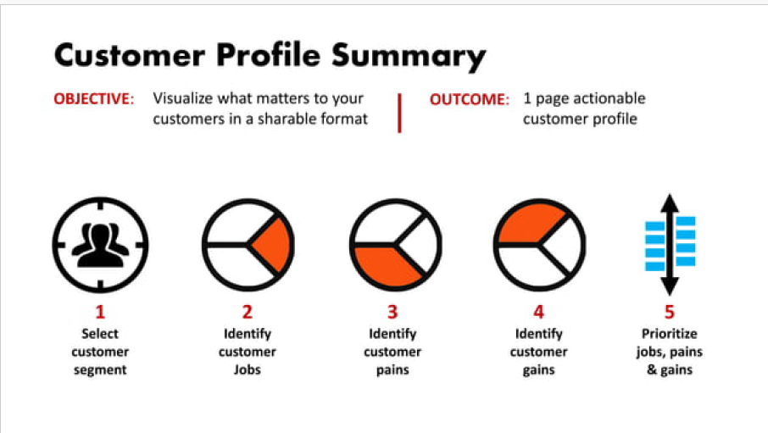

Slide 21
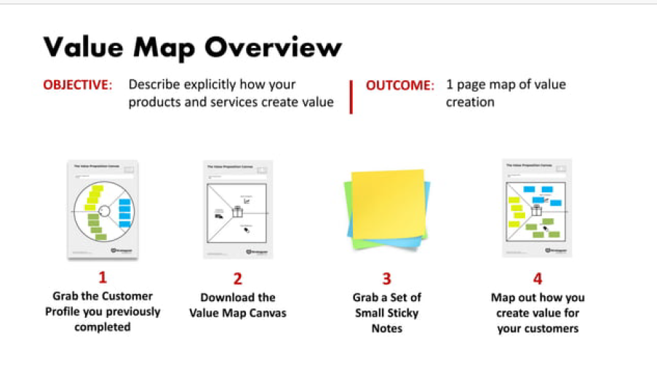

Slide 22
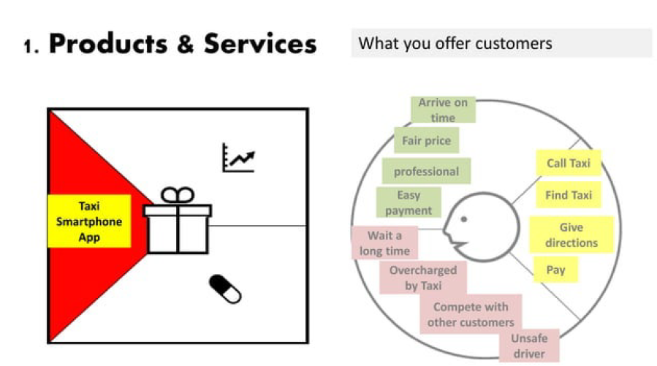
Include all the products and services you are going to deliver. About each one, ask yourself:
Can the product/service help to accomplish any job-to-be-done, whether functional, social, emotional, needs, wishes, roles, etc.?
Is the product/service tangible, digital/virtual, or financial?
Is the product/service crucial or trivial? How relevant is it?
How often is the product/service used by my customer?

Slide 23
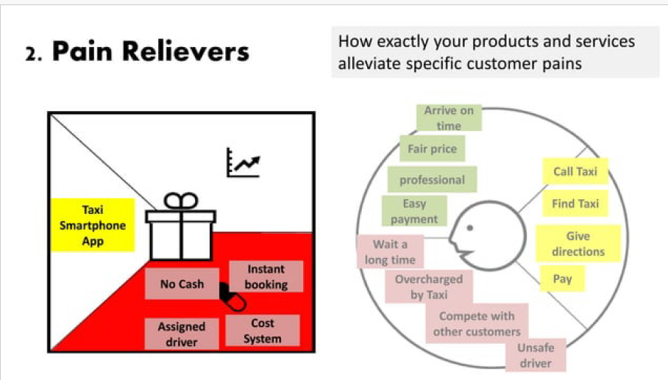
Describe how your product/service relieves the customer’s pains. Identify if you reduce their costs, negative feelings, efforts, risks, negative consequences, mistakes…
To help you out, ask if your product/service:
produces savings (in terms of time, money, effort, etc.);
makes your customer feel better (they end up with frustrations, discomforts, things that give headaches, etc.);

Slide 24
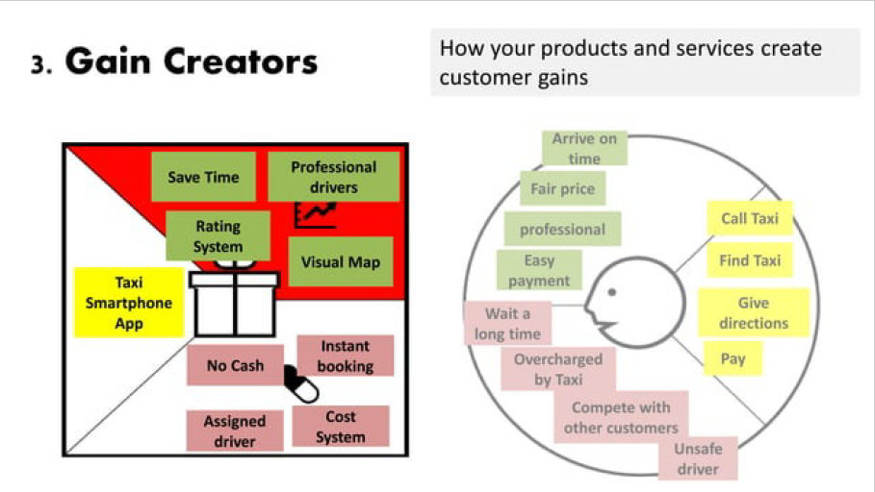
Involve how the product/service offers the customer added value, what are the benefits your product brings, and if your customer’s wishes and expectations are reached. After all, how it makes your customer happier.
To do that, ask if your product/service:
creates savings that make your customer happy (in terms of time, money, effort, etc.);
produces results that your customer expects or that goes beyond their expectations (better level of quality, more of something, less of another);

Slide 25
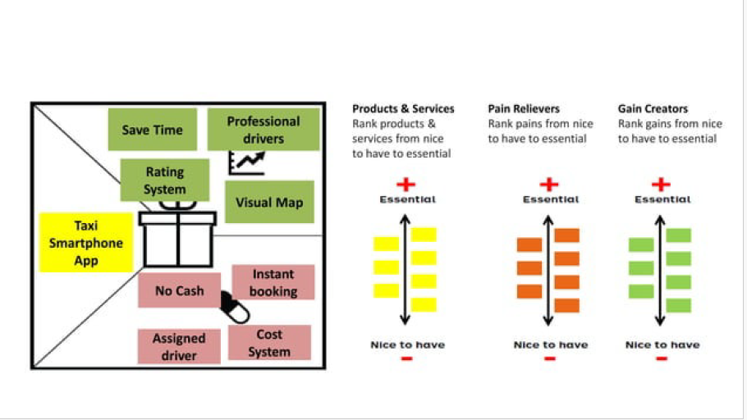

Slide 26
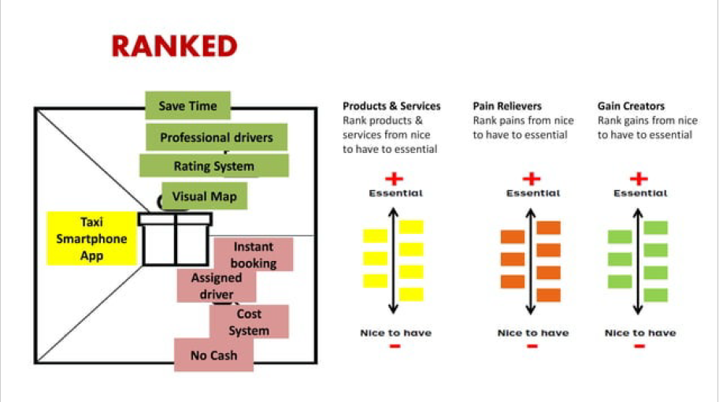

Slide 27
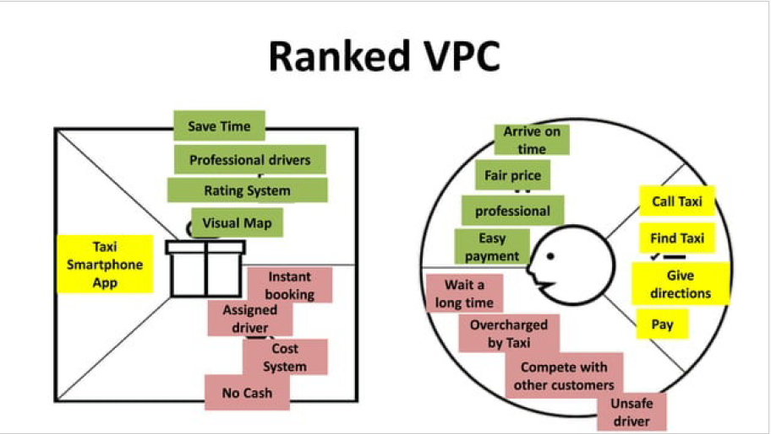

Slide 28
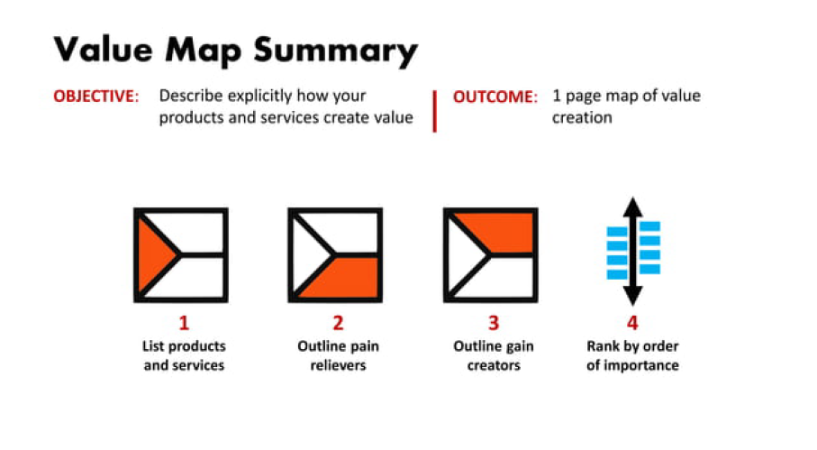

Slide 29
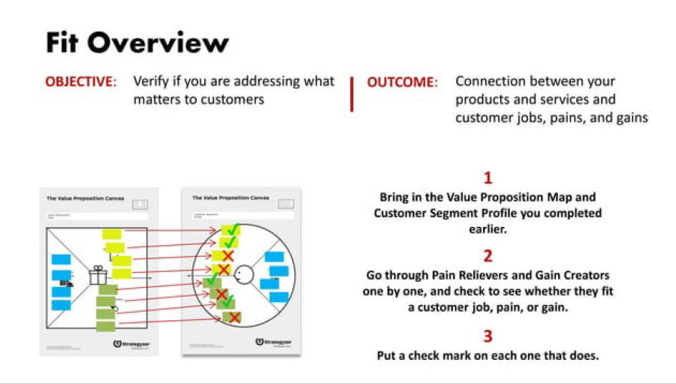

Slide 30
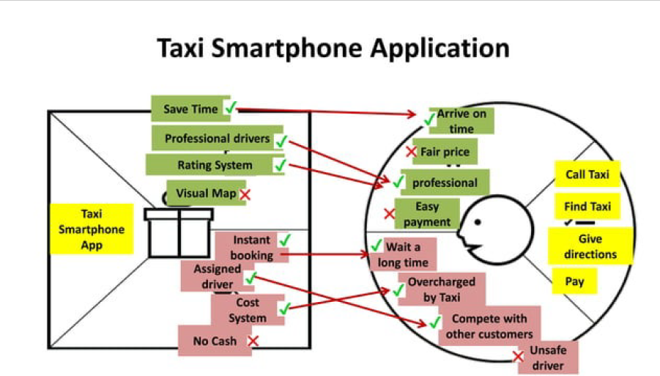

Slide 31
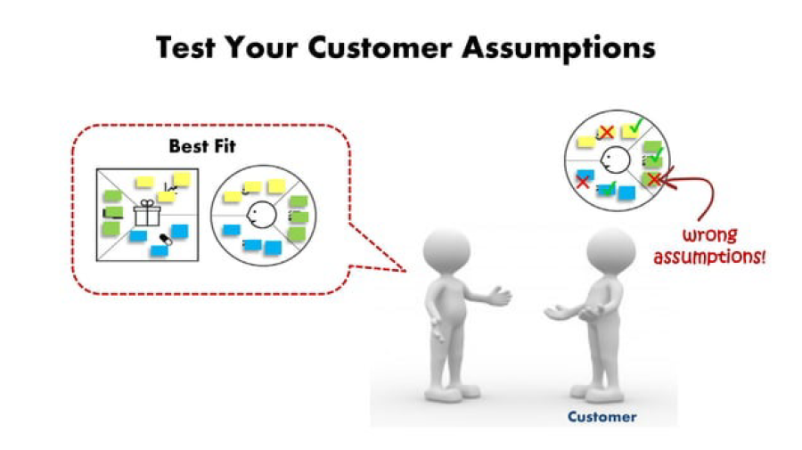

Slide 32
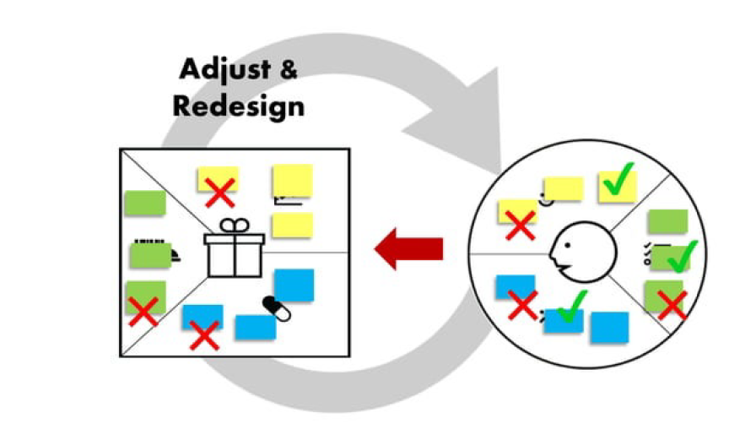

Slide 33
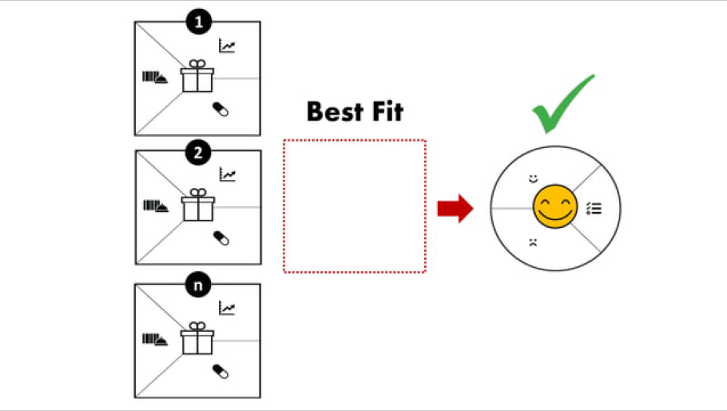

Slide 34
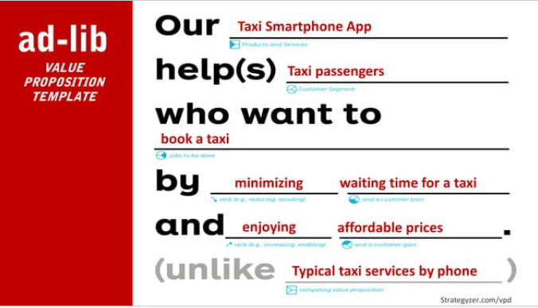

Slide 35
Business Model Canvas

Slide 36
Business model canvas is a visual template that helps entrepreneurs document an existing business model or develop a new one. Alexander Osterwalder created it in 2005, based on his academic work on business model ontology.
The business model canvas was designed with startups in mind. It quickly became an alternative to the traditional business plan which wasn’t agile enough to accommodate newly emerging companies.
The revolutionary thing about the business model canvas was that it allowed entrepreneurs to capture a business model on a single page. This made business planning simpler and more structured.

Slide 37
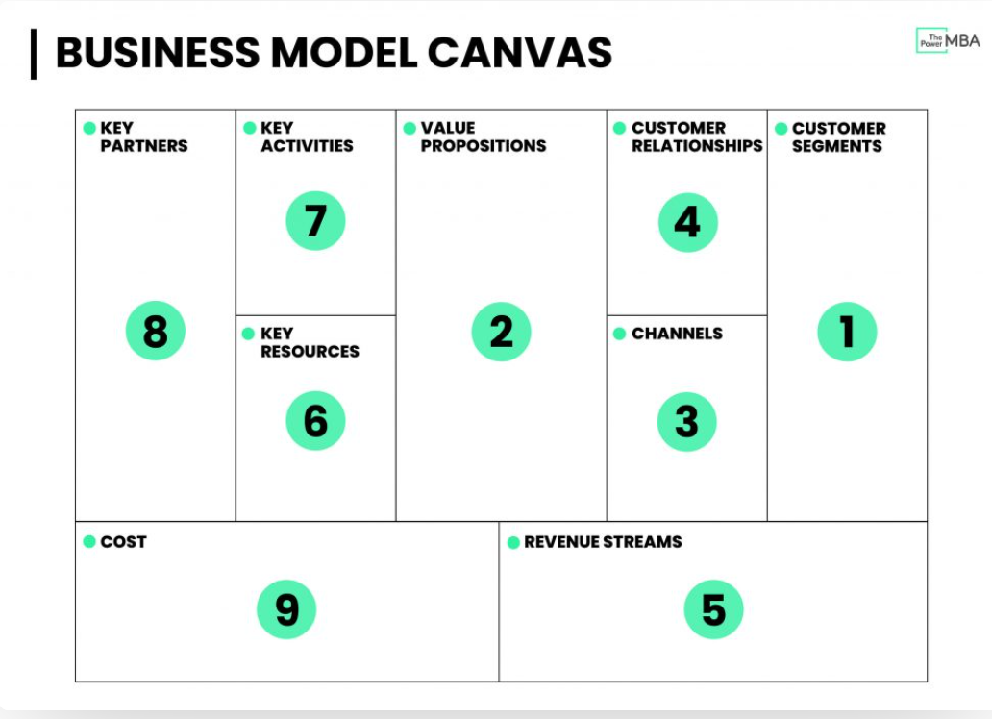
Notes:
The business model canvas allows us to carry out a high-level analysis without drilling down and getting lost in the details.

Slide 38
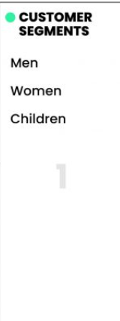
Fashion retail giant Zara
The first block of the Business Canvas Model is about understanding who is the most important customer(s) you’re delivering value to. Or, in other words, who are they? What do they do? And why would they buy your product or service?
Buyer personas are fictional depictions of an ideal or hypothetical client. Typically when brainstorming a buyer persona you’d want to define certain characteristics (age, demographic, gender, income, industry, pain points, goals, etc.)

Slide 39
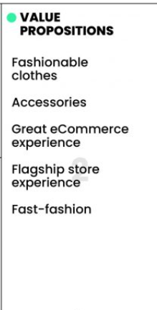
The second phase is about figuring out your company’s value propositions, and importantly, your UVP (unique value proposition). The “what” that makes customers turn to you, over your competitors? Which of their problems are you best at solving?
Zara’s principal value propositions are fairly clear. They offer various ranges of stylish men’s, women’s, and children’s clothing and accessories at an affordable price.
Notes:
Zara demonstrates its aesthetic evolution to customers through its flagship stores. The recent opening of their Hudson Yards, New York City flagship is a great example of this.

Slide 40
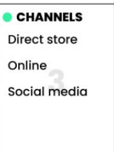
The next step is to ask yourself how you are reaching your customers, and through which channels?
This includes both the channels that customers want to communicate with you as well as how they’ll receive your products or services.
Is it going to be a physical channel? (store, field sales representatives, etc.) Or is it a digital channel? (mobile, web, cloud, etc.).

Slide 41
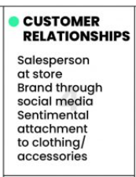
Once you have acquired customers, you will need to think about how you can build, nurture, and grow those relationships.
Zara’s relationship with its customers is threefold, and lies somewhere in the middle of transactional and personal:
Salesperson at store
Brand through social media
Sentimental attachment to a product

Slide 42
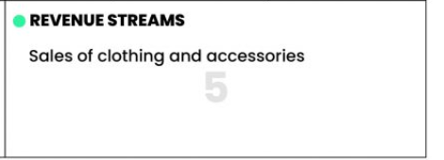
Now that you’ve described how you are going to create real value for your customers, it’s time to look at how you plan to capture that value.
At Zara, it’s extremely simple. They make their money by selling clothes and accessories either at a store or online.

Slide 43
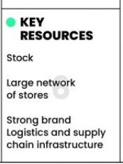
Now it’s time to move over to the left side of the business canvas model and look at what we need, internally, to deliver our value propositions.
The key resources are all things you need to have, or the assets required to create that value for customers.
This could be anything from intellectual property (patents, trademarks, copyrights, etc.) to physical holdings (factories, offices, delivery vans, etc.) right down to finances (the initial cash flow perhaps needed to start your brand)

Slide 44
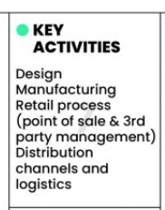
The next step is to define the key activities – the areas you need to be good at to create value for your customers.

Slide 45
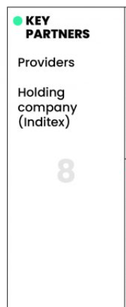
Most modern business models now require brands to build out and work with various key partners to fully leverage their business model.
This includes partnerships such as joint ventures and non-equity strategic alliances as well as typical relationships with buyers, suppliers, and producers.
Zara requires strategic partnerships with many different providers if they are to design and produce their collections.
Another key partner is their major holding company, Inditex.

Slide 46
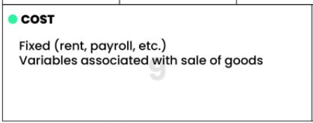
The final step of the Business Model Canvas is to ask yourself, how much is it going to cost to run this model?
This includes some of the more obvious needs such as manufacturing costs, physical space, rent, payroll, but also areas such as marketing activities.

Slide 47
